Slide 1
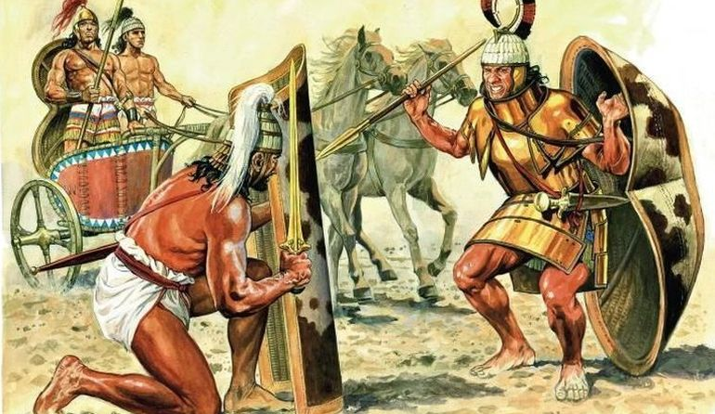
The Myceneans
Goal/s:
Identify the key features of the Mycenean civilisation
Week 5 Lesson 1
Ms Barrie

Slide 2

During the Bronze Age, a warlike society developed around the Greek city of Mycenae. The Myceneans were great warriors and traders who lived in small kingdoms centered around heavily fortified palaces. The wealthy Mycenean civilization reached its peak in about 1600BCE. However, by around 1250BCE the Mycenaean world was under threat from foreign invaders, and by around 1200BCE their cities began to be abandoned or destroyed. Within a hundred years the Mycenaean strongholds had fallen and a period known as the ‘Dark Ages’ had begun.
Notes:
Discussion Question – What is similar to the Minoans? What is different to the Minoans?

Slide 3
Key Information
Mycenaean is the term applied to the art and culture of Greece from ca. 1600 to 1100 B.C.
The name derives from the site of Mycenae in the Peloponnesos, where once stood a great Mycenaean fortified palace.
Mycenae is celebrated by Homer as the seat of King Agamemnon, who led the Greeks in the Trojan War.

Slide 5
ACTIVITY 1 – Source Analysis
Each group will receive a source (7 groups)
Answer the questions on the source sheet – and be prepared to share!
Rotate every 4 minutes

Slide 6
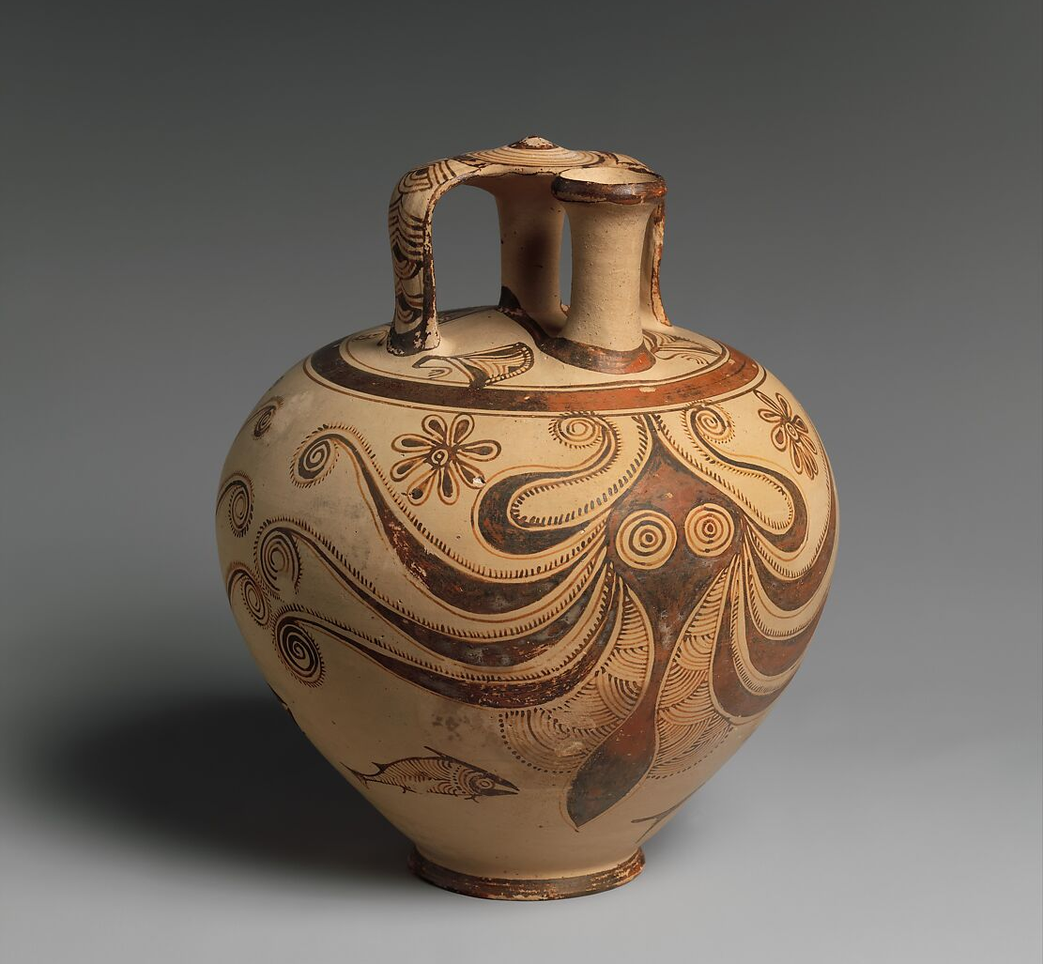
Source 1
Octopus Jar is decorated with an octopus was found in a cemetery at a Mycenean colony on the island of Rhodes. Mycenean artists who often painted subjects inspired by the sea.

Slide 7
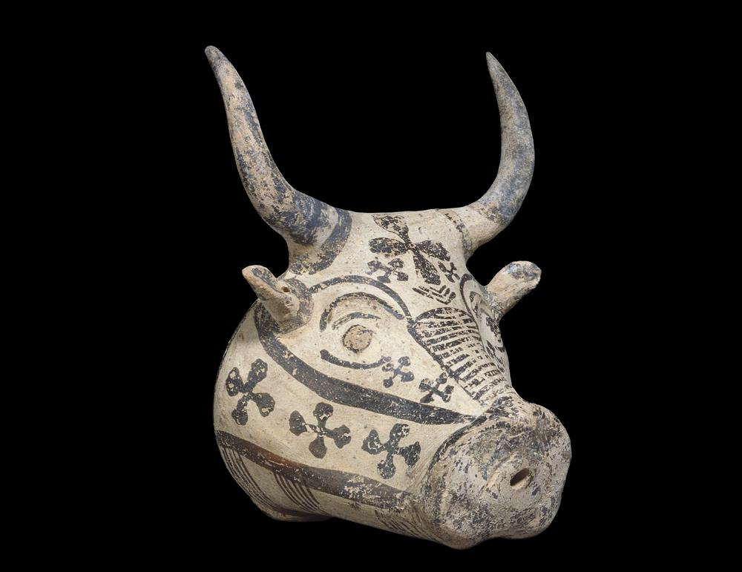
Source 2
This clay bull’s head with small holes in its mouth was used to sprinkle water at religious ceremonies. The bull was the most common animal shape for these ritual sprinklers.

Slide 8
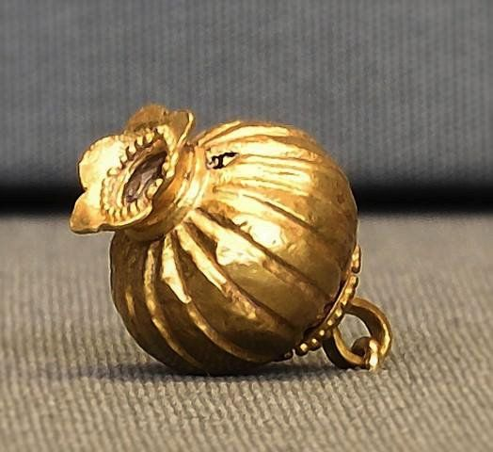
Source 3
Pomegranate Pendant. This gold pendant was found in Cyprus, where many Mycenaean artists and traders settled as their civilization crumbled. It was made by a Mycenean craftsman in around 1300 BCE and is decorated with tiny gold granules.

Slide 9
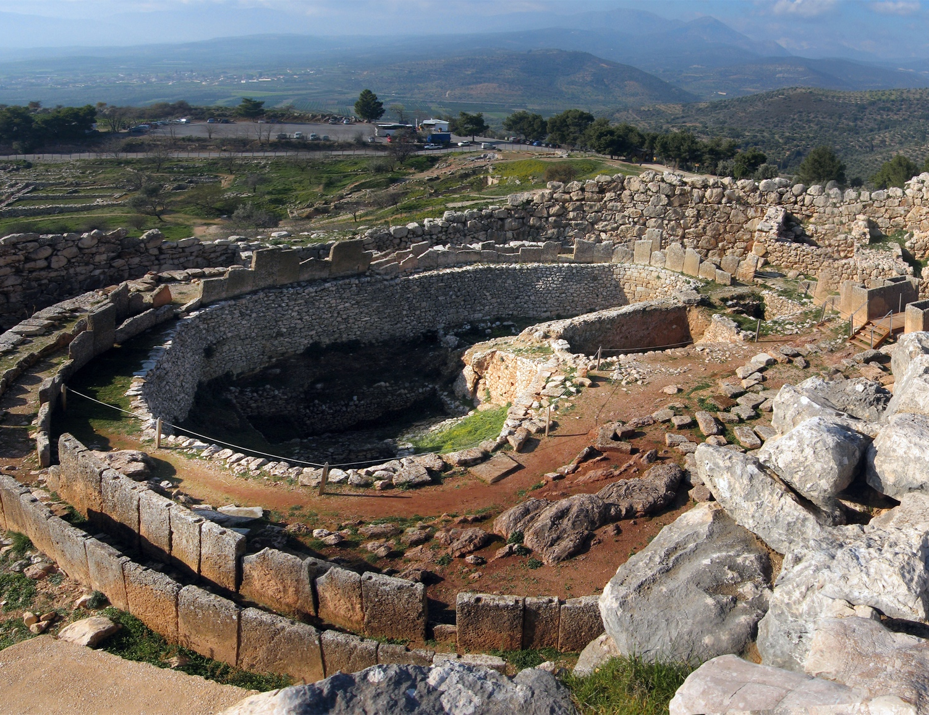
Source 4
Grave Circle.
In 1876, Heinrich Schliemann excavated a royal burial ground at Mycenae. It contained tombs called shaft graves enclosed by a wall. The graves held vast amounts of gold jewelry that date from around 1600BCE.

Slide 10
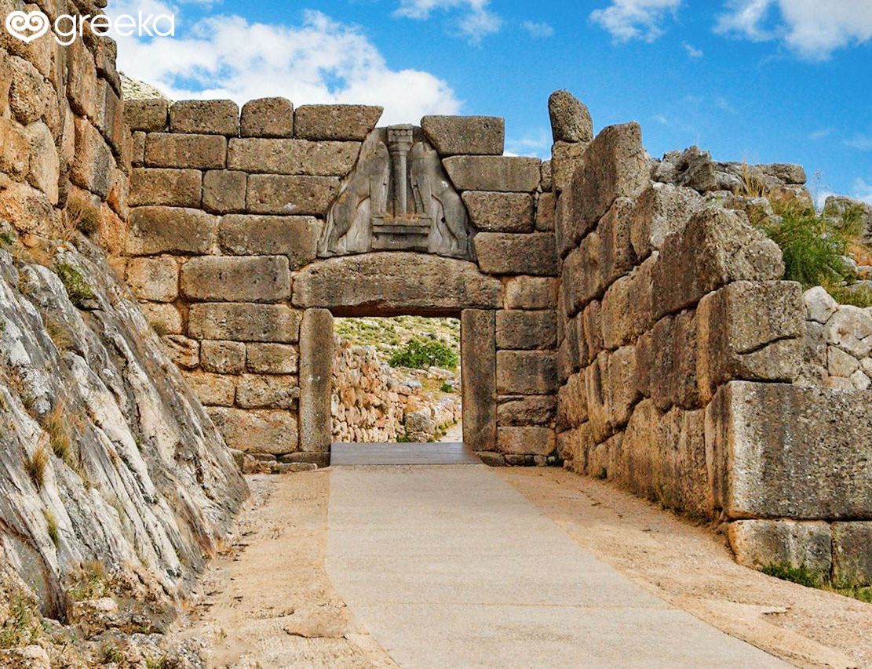
Source 5
Lion Gate.
The main entrance through Mycenae’s city walls was a huge, stone gateway, decorated with the sculptures of two lions on either side of a pillar. This may have been the symbol of Mycenae’s royal family.

Slide 11
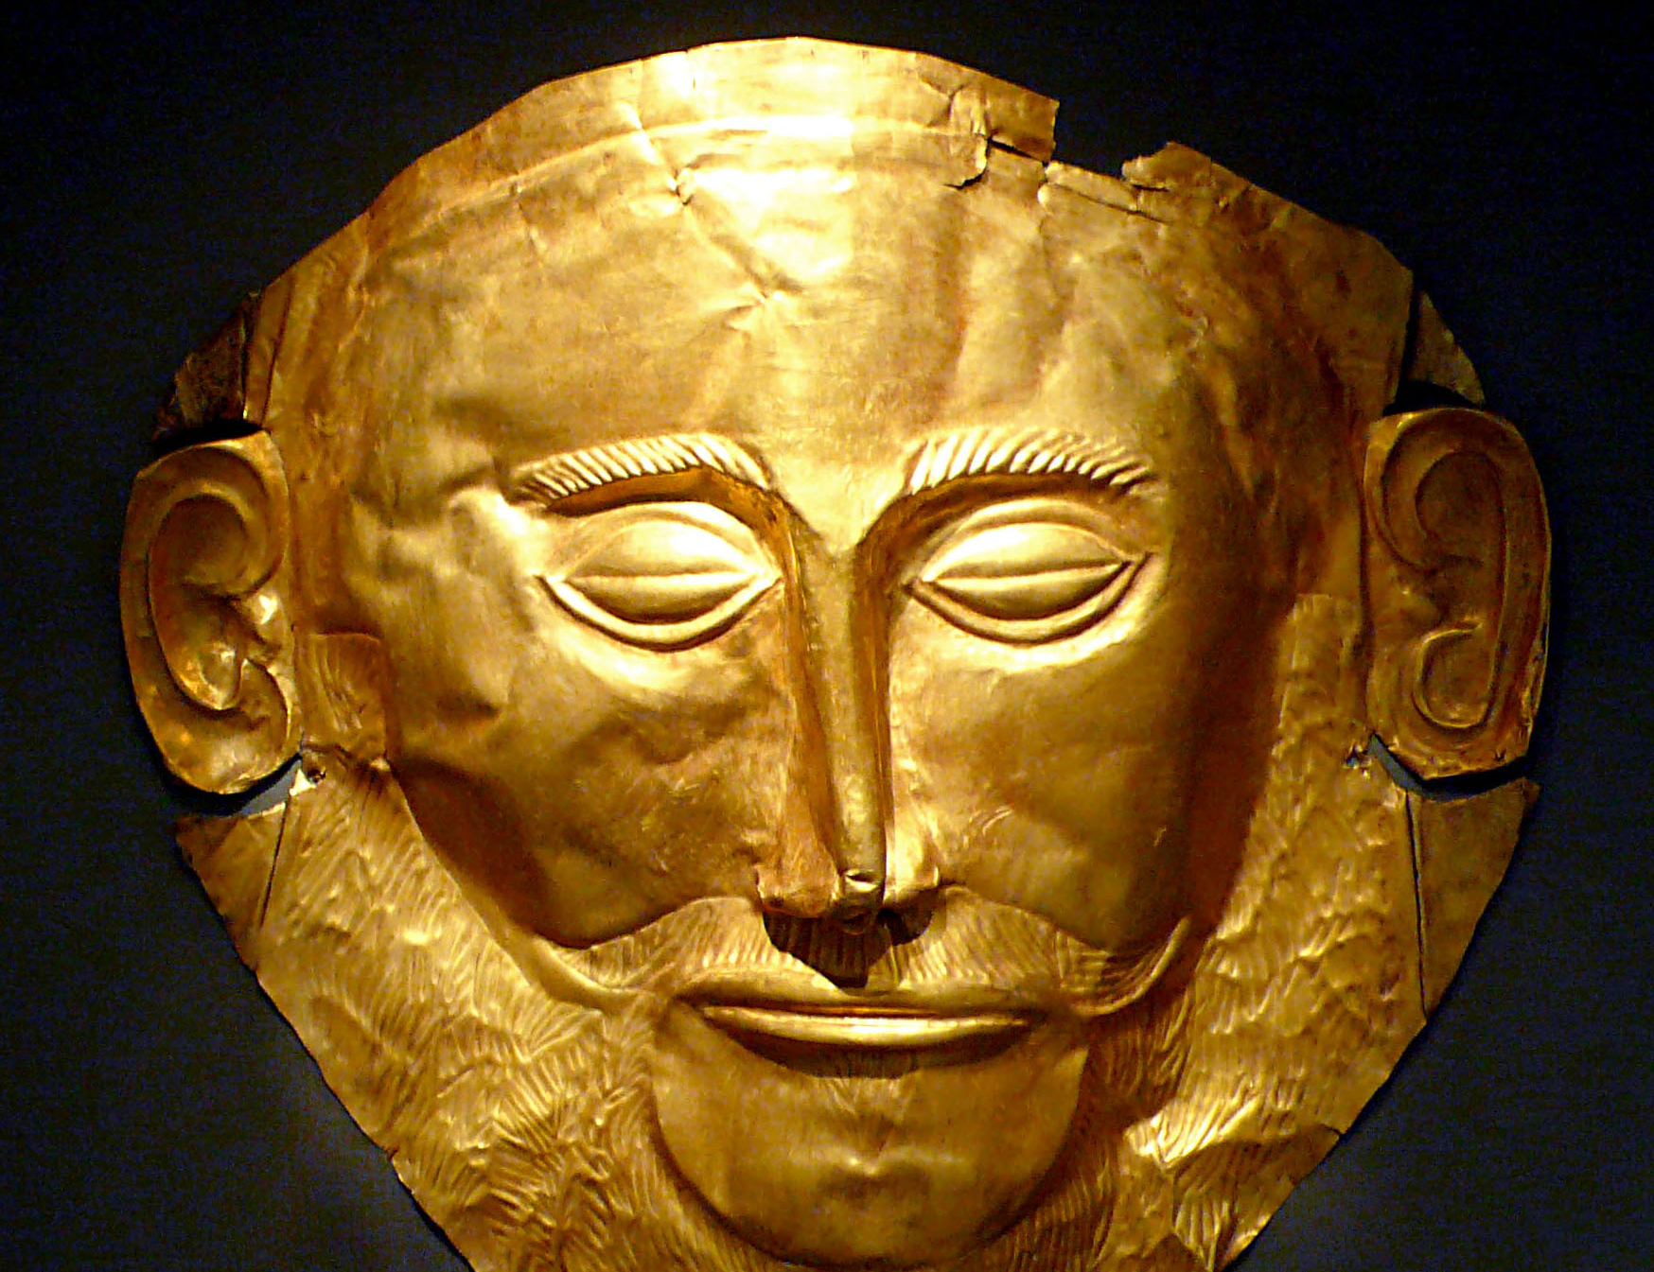
Source 6
Mask of Agamemnon. Five of the royal people buried in the Mycenean shaft graves wore gold funeral masks. Heinrich Schliemann mistakenly believed that the death mask shown here belonged to Agememnon – the legendary king of Mycenae during the Trojan War. It has since been dated to an earlier time.

Slide 12
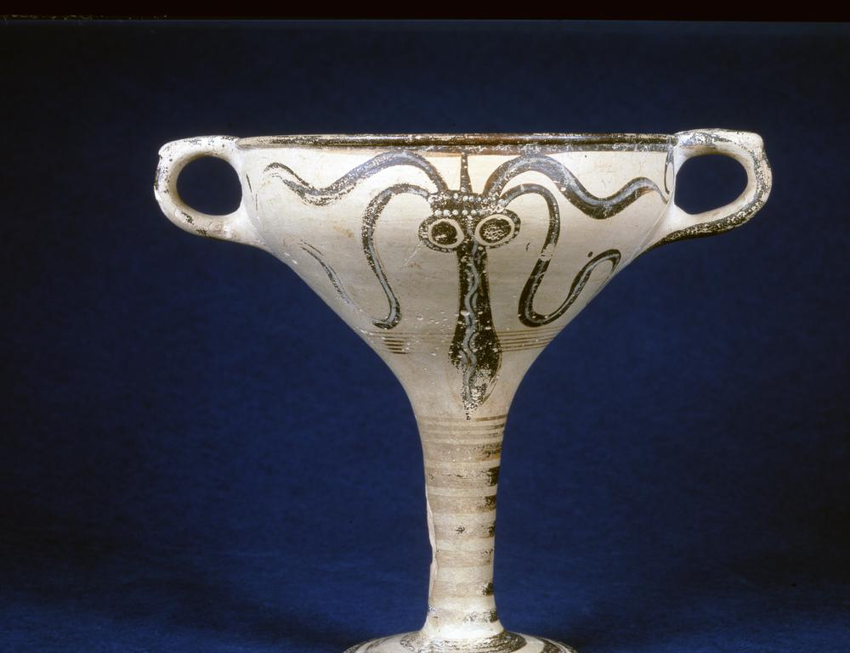
Source 7
Fish Cup. Mycenaean artists often worked for the king ang built their workshops close to the palace. The shape of this long-stemmed cup, decorated with cuttlefish, was invented by the Mycenaeans.

Slide 13
SUMMARY
Describe the Mycenaean society in 10 words.
EXTRA TIME:
https://www.youtube.com/watch?v=NeApjn3Pf1o&ab_channel=HistoricalAdventure

